Slide 1
IBM University Engagement Project Submission “Exploring the Power of Agentic AI with IBM Granite and LangFlow”
By: Deven A Gol

Slide 2

Project Tile – Agentic AI for Mental Health Awareness & Suicide Prevention
Domain of Project – Healthcare
Student Name | Recent Passport Photo | Email ID | Mobile number [WhatsApp]
DEVEN GOL |  | Devengol.dce@charusat.ac.in | 7984792228

Slide 3
Problem Statement -Agentic AI for Mental Health Awareness & Suicide Prevention
The Challenge
Mental health issues such as depression, anxiety, and suicidal thoughts are growing worldwide. Stigma, lack of awareness, and limited access to timely help prevent many individuals from seeking support. Traditional systems are often reactive, leaving gaps in early detection and preventive care.
The Objective
Build an Agentic AI-powered Mental Health Awareness & Suicide Prevention Agent that is empathetic, proactive, and safe. The solution should:
Promote Awareness & Education – Share accessible resources on mindfulness, coping strategies, and self-care.
Enable Early Detection (RAG) – Use Retrieval-Augmented Generation to identify distress signals in conversations, journaling inputs, or safe online data.
Provide Empathetic Support – Build a conversational agent that listens actively and responds with empathy (with clear disclaimers: not a substitute for professional medical advice).
Predict & Prevent Risks – Forecast stress peaks, suggest preventive strategies, and issue alerts when high-risk signals are detected (with consent).
Connect to Human Support – Link users to helplines, counselors, or community support for timely intervention.

Slide 4
Technology Used
LangFlow orchestrates the multi-agent workflow, IBM watsonx.ai provides the AI platform, and Granite Models deliver intelligent reasoning, emotion analysis, and personalized mental health support.
I used LangFlow + IBM watsonx.ai + Granite Models
LangFlow serves as the visual orchestration platform for designing and managing the multi-agent workflow. It enables seamless integration of AI components through a drag-and-drop interface, facilitating prompt engineering, workflow automation, agent coordination, and interaction management. LangFlow simplifies the development of complex Agentic AI applications without extensive coding.
IBM watsonx.ai provides the enterprise-grade AI development environment that powers the solution's intelligence layer. It offers access to foundation models, prompt engineering capabilities, model deployment, and governance features, enabling secure and scalable AI-driven mental health support.
IBM Granite Models act as the core Large Language Models (LLMs) responsible for understanding user inputs, analyzing emotions, assessing mental health risks, and generating context-aware responses. These models provide natural language understanding and reasoning capabilities essential for mental health awareness and suicide prevention.

Slide 5
Proposed Solution
Agentic AI for Mental Health Awareness and Suicide Prevention
The proposed solution is a multi-agent AI-powered Mental Health Awareness and Suicide Prevention System built using LangFlow, IBM watsonx.ai, and Granite Models to provide personalized, proactive, and real-time mental health support. The system addresses critical challenges in mental health awareness, emotional well-being monitoring, early suicide risk detection, and timely intervention through an intelligent, modular architecture.
At its core, the solution utilizes a Retrieval-Augmented Generation (RAG) pipeline to access reliable mental health knowledge from trusted sources such as the World Health Organization (WHO), National Institute of Mental Health (NIMH), Centers for Disease Control and Prevention (CDC), and validated psychological wellness resources. This information is embedded and stored in a vector database, enabling the system to retrieve and generate accurate, context-aware responses related to mental health conditions, coping mechanisms, crisis support, and preventive care using Granite models.
The system consists of four key agents:
1. Mental Health Knowledge Agent
Retrieves and summarizes evidence-based mental health information using RAG.
2. Emotional Assessment Agent
Detects emotional states such as stress, anxiety, loneliness, hopelessness, sadness, or emotional distress.
Continuously monitors behavioral and emotional patterns to identify early warning signs.
3. Personalized Support & Recommendation Agent
Generates personalized wellness plans based on user emotional status, age group, lifestyle, and mental health needs.
4. Suicide Risk Detection & Crisis Intervention Agent
Performs risk assessment and classifies users into Low, Moderate, High, or Critical risk categories.
LangFlow is used to orchestrate agent workflows and manage inter-agent communication, while IBM watsonx.ai provides scalable model deployment, embeddings, governance, security, and responsible AI capabilities. Granite Models power advanced reasoning, sentiment understanding, emotional analysis, summarization, and personalized support generation.

Slide 6
Langflow component Used
For Agentic AI for Mental Health Awareness & Suicide Prevention, you can present the components in a more professional and impactful way:
1. User Interaction (Chat Input)
Serves as the primary interface where users share thoughts, emotions, concerns, or mental health-related queries through natural language conversations.
2. IBM watsonx.ai Agent
Acts as the intelligent decision-making engine, analyzing user inputs, assessing emotional states, identifying potential mental health risks, and generating personalized support strategies.
3. IBM Granite Model Granite-4.0-8B-Instruct
A powerful and efficient Large Language Model (LLM) that enables real-time emotional understanding, contextual reasoning, suicide risk assessment, and personalized mental health guidance.
4. AI Response Interface (Chat Output)
Delivers empathetic, context-aware responses including mental health awareness content, coping strategies, wellness recommendations, emotional support, and crisis intervention guidance.
5. Knowledge & Data Repository (File Component)
Stores and manages user conversations, mood tracking records, emotional wellness history, mental health assessments, intervention logs, and trusted mental health resources to enable continuous monitoring and personalized support.

Slide 7
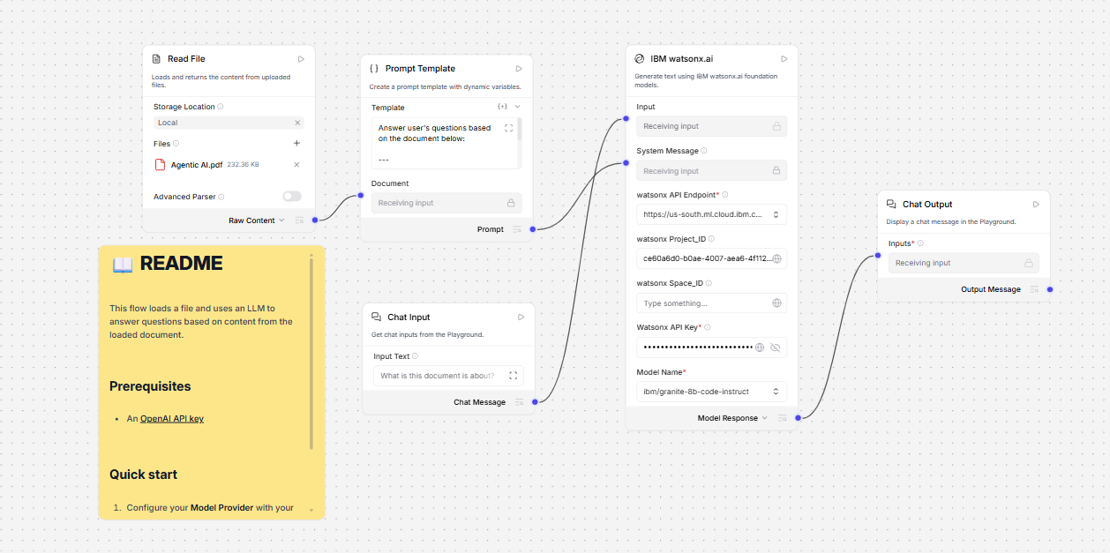
Langflow workflow

Slide 8
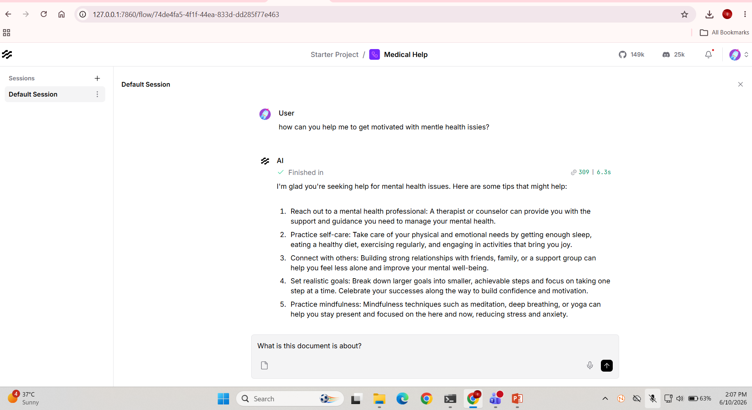

Slide 9
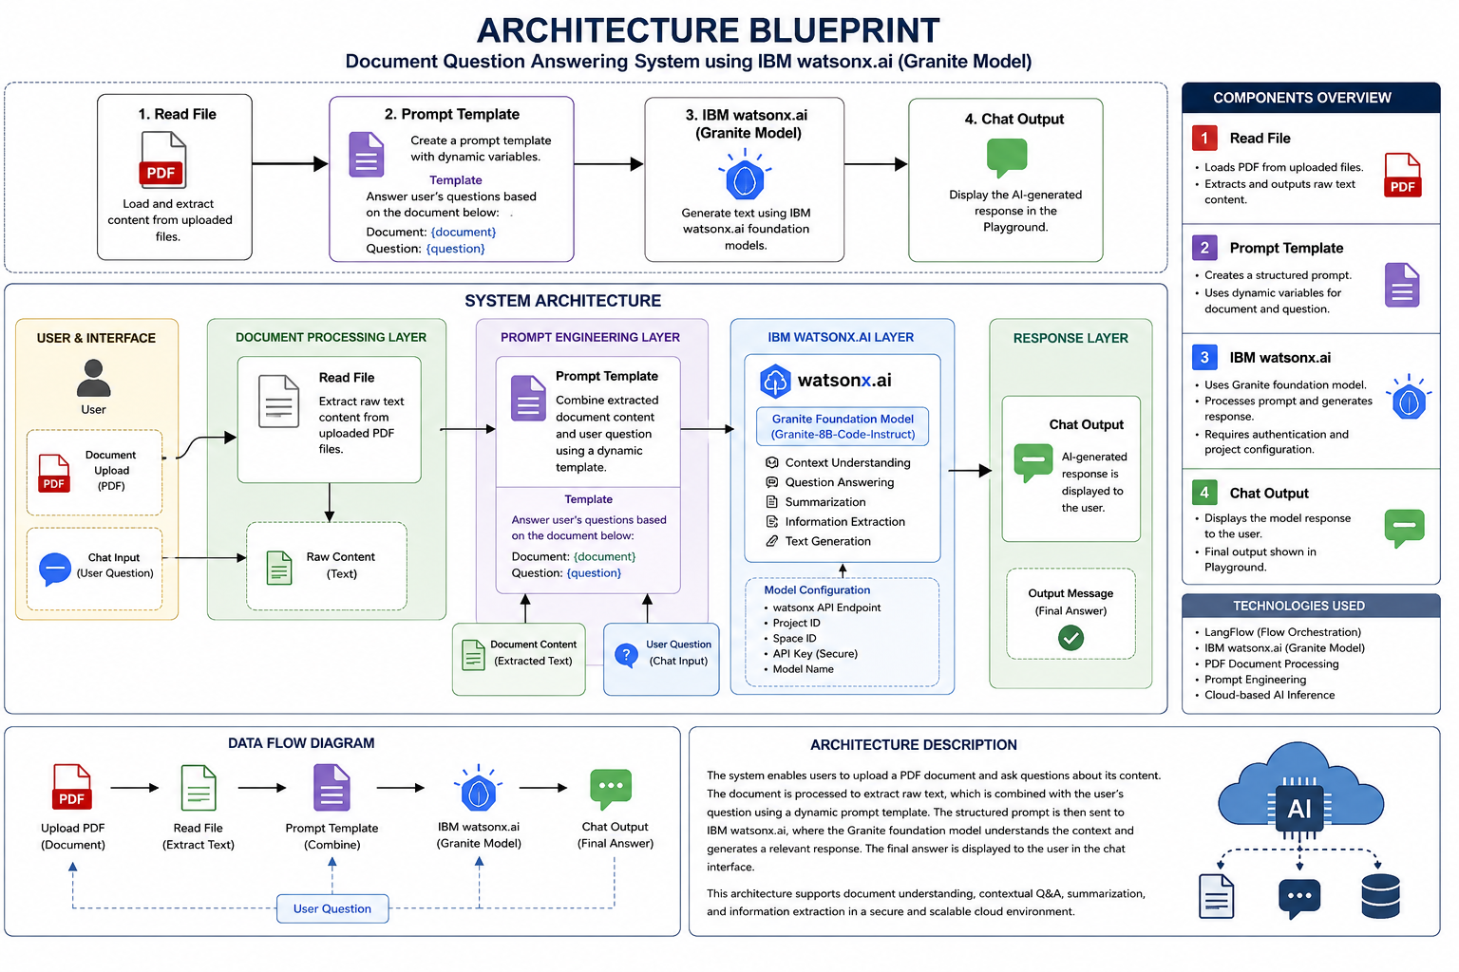

Slide 10

Role of Agentic AI in Mental Health Awareness and Suicide Prevention Solution
Agentic AI acts as an intelligent, autonomous assistant that continuously monitors emotional well-being, identifies mental health risks, and provides personalized interventions to support users.
Key Roles
✅ Mental Health Monitoring
Analyzes user conversations, emotions, and behavioral patterns.
Detects signs of stress, anxiety, depression, and emotional distress.
✅ Early Suicide Risk Detection
Identifies suicidal ideation using sentiment analysis and NLP.
Classifies users into low, medium, or high-risk categories.
✅ Personalized Awareness & Guidance
Delivers customized mental health education and coping strategies.
Recommends mindfulness exercises and wellness activities.
✅ Multi-Agent Collaboration
Emotion Analysis Agent
Risk Assessment Agent
Intervention Agent
Resource Recommendation Agent
Emergency Response Agent
✅ Real-Time Crisis Intervention
Provides 24/7 empathetic conversational support.
Connects users with counselors, helplines, or emergency services when needed.

Slide 11
Technology Used
Langflow platform
For designing and orchestrating multi-agent workflows visually
IBM Grainte model
For eg – ibm-granite-3-2-8b – For natural language understanding, reasoning, and personalization
IBM Cloud
It provides the infrastructure to build, deploy, and scale the Nutrition Agent efficiently. IBM Cloud enables a reliable, secure, and scalable environment for deploying the Nutrition Agent.
RAG
RAG to fetch real data first, then generate intelligent answers, making the Nutrition Agent more trustworthy and effective.
IBM Watsonx.ai
For model deployment, embeddings, and AI governance

Slide 12
Novelty and Uniqueness
The proposed solution introduces a novel multi-agent Agentic AI framework that integrates emotional intelligence, autonomous decision-making, real-time suicide risk prediction, personalized intervention planning, and human-AI collaboration within a unified mental healthcare ecosystem, moving beyond conventional chatbot-based mental health support systems.
Autonomous Multi-Agent Intelligence – Multiple AI agents collaborate to analyze emotions, assess risks, and deliver appropriate interventions.
Proactive Rather Than Reactive Support – Continuously detects early signs of mental distress before a crisis occurs.
Dynamic Personalized Intervention – Provides tailored mental wellness recommendations based on individual needs and behavior.
Real-Time Suicide Risk Prediction – Identifies suicide warning signs in real time using AI-driven behavioral and sentiment analysis.
Explainable AI-Driven Decision Making – Generates transparent and understandable reasons behind recommendations and risk assessments.
Human-AI Collaborative Care Framework – Supports mental health professionals through intelligent monitoring and early-warning assistance.
Ethical and Responsible AI Architecture – Ensures privacy, fairness, security, and consent-based mental healthcare support.

Slide 13
Git Hub Link
https://github.com/deven215/Langflow.git
·
·
·

Slide 14
Future Scope of Agentic AI for Mental Health Awareness & Suicide Prevention
Multimodal Emotion Recognition – Integrate text, voice, facial expressions, and wearable sensor data for more accurate mental health assessment.
Predictive Mental Health Analytics – Use advanced AI models to forecast mental health crises before they occur.
Integration with Wearable Devices – Monitor stress, sleep, heart rate, and activity levels for real-time wellness tracking.
Personalized Digital Therapeutics – Deliver adaptive therapy plans and evidence-based interventions tailored to individual needs.
Healthcare System Integration – Connect with hospitals, counselors, and telemedicine platforms for seamless care coordination.
Multilingual and Cross-Cultural Support – Expand accessibility through support for diverse languages and cultural contexts.
Federated and Privacy-Preserving AI – Enhance data security using decentralized learning and privacy-preserving techniques.
Advanced Human-AI Collaboration – Enable closer collaboration between AI agents, psychologists, and caregivers for improved outcomes.
Community and Peer Support Networks – Facilitate safe, AI-moderated peer support communities.
Global Suicide Prevention Ecosystem – Develop a scalable platform capable of supporting mental health initiatives across different regions and populations.
·
·
·

Slide 15


